Slide 1
Introduction to the Internet and the Web
Dr. Raj Singh

Slide 2
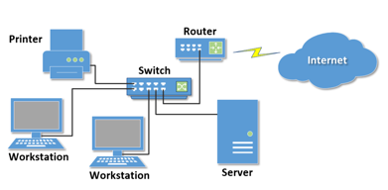
What is a Computer Network?
two or more computers connected together for the purpose of communicating and sharing resources

Slide 3
Types of Networks
PAN - Personal Area Network
LAN - Local Area Network
MAN - Metropolitan Area Network
WAN - Wide Area Network

Slide 4
Intranet & Extranet
Intranet
A private network contained within an organization or business used to share information and resources among coworkers.
Extranet
A private network that securely shares part of an organization’s information or operations with external partners

Slide 5
Internet
The interconnected network of computer networks that spans the globe.

Slide 6


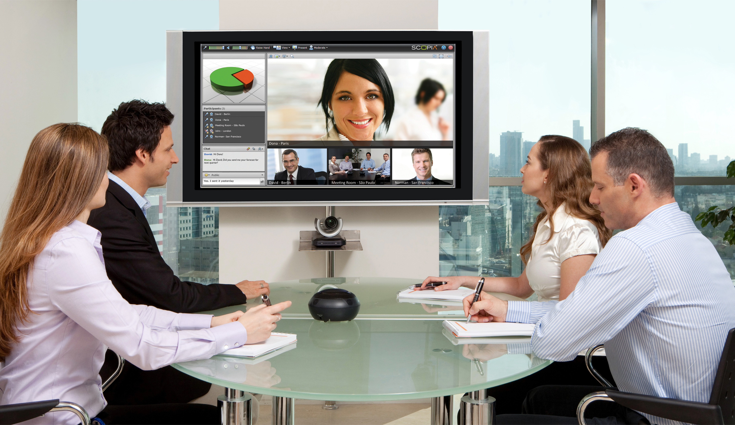
Internet…
Internet has revolutionized our everyday life.
It has changed:
Communication
Education
Shopping
Entertainment
Health care and many more
6￼

Slide 7
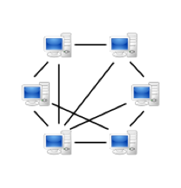
History of the Internet
Began with Point-to-Point (P2P) communication between computers (later Peer-to-peer)
First version of the Internet was called ARPANET Mainly used by universities, scientists, and government agencies to share information
Internet2

Slide 8
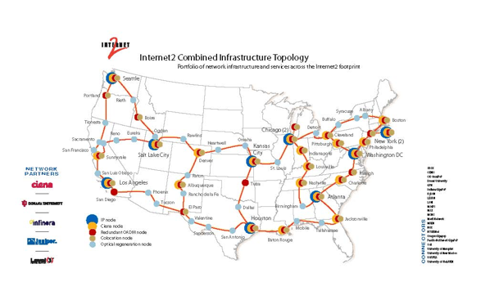
Internet2

Slide 9
Internet
http://www.cablemap.info/
http://www.level3.com/~/media/files/maps/en-network-services-level-3-network-map.ashx#.UUY45xw3t2A

Slide 10
Services Provided by the Internet
Electronic Mail (E-mail)
World Wide Web (WWW)
File Sharing
Alternative to traditional telephone (Voice over IP)
Social Networking
Skype, Google Hangouts, Facetime
Cloud Storage

Slide 11

World Wide Web (WWW)
Not exactly the same as the Internet
Internet is a system of interconnected computer networks
World Wide Web is a collection of text documents and other resources linked by hyperlinks and URLs( Uniform Resource Locator)

Slide 12
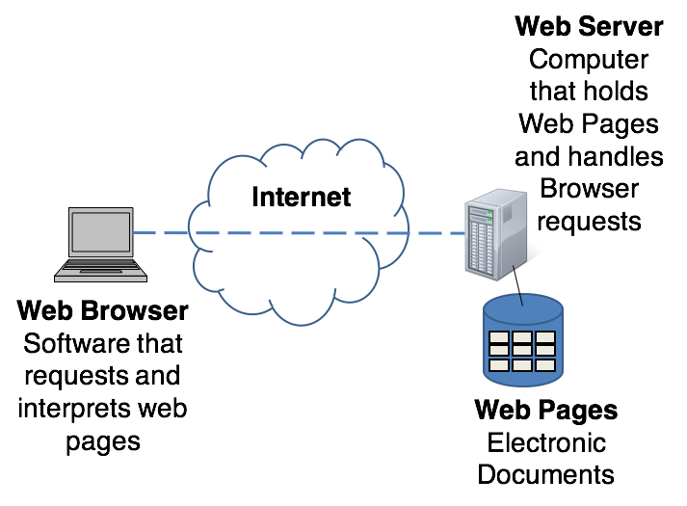
Accessing a Web Page

Slide 13
Protocols
Rules that describe the methods used for clients and servers to communicate with each other over a network.
There is no single protocol that makes the Internet and Web work.
A number of protocols with specific functions are needed.

Slide 14
Some Protocols
SMTP -Simple Mail Transfer Protocol
HTTP - HyperText Transfer Protocol
TCP/IP - Transmission Control Protocol / Internet Protocol
FTP - File Transfer Protocol

Slide 15
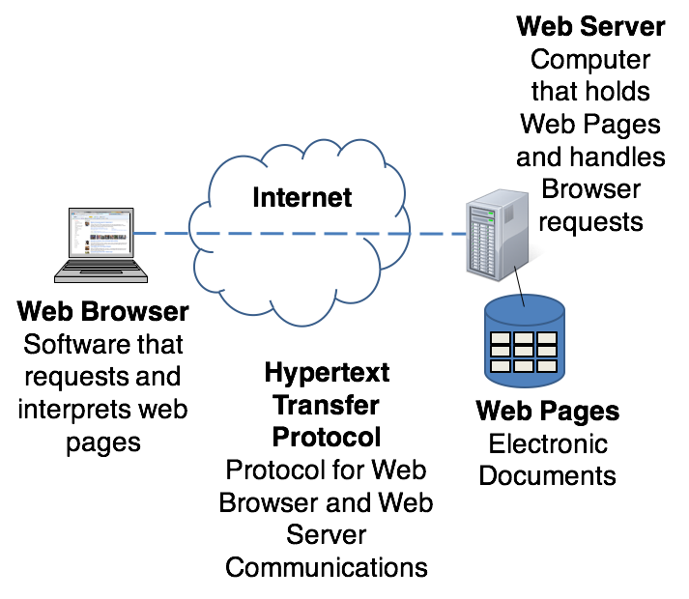
Accessing a Web Page

Slide 16
IP Address
Each device connected to the Internet has a unique numeric IP address.
Two versions of IP addresses:
IPv4:
192.0.2.235
IPv6:
2002:4559:1FE2::4559:1FE2

Slide 17
Domain Name
Locates an organization or other entity on the Internet
Eg: www.google.com
DNS server maps the URL to unique IP address.
Domain Name System

Slide 18
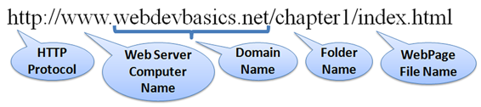
Uniform Resource Identifier
URI – Uniform Resource Identifier
identifies a resource on the Internet
URL – Uniform Resource Locator
a type of URI which represents the network location of a resource such as a web page, a graphic file, or an MP3 file.

Slide 19
TLD Top-Level Domain Name
A top-level domain (TLD) identifies the right-most part of the domain name.
Current generic TLDs: .com, .org, .net, .mil, .gov, .edu, .int, .aero, .asia, .cat, .jobs, .name, .biz, .mobi, .museum, .info, .coop, .post, .pro, .tel, .travel, .xxx

Slide 20
County Code TLDs
Two character codes originally intended to indicate the geographical location (country) of the web site.
In practice, it is fairly easy to obtain a domain name with a country code TLD that is not local to the registrant.
Examples:
.tv, .ws, .au, .jp, .uk
See http://www.iana.org/cctld/cctld-whois.htm

